Slide 1
Design of a Virtual Reality Game-Based Learning Module for Engineering Education
Zachary Allen

Slide 2
Report Outline
Motivation
Objective
Design Requirements
Design Constraints
Design Approach
Game Interactions
The Task Plan
Timeline
Implementations
Conclusion
Acknowledgement

Slide 3
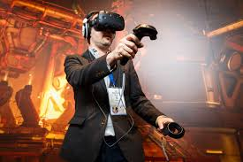
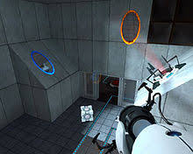

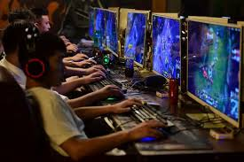
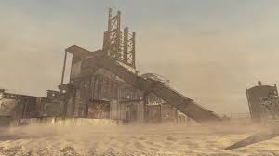
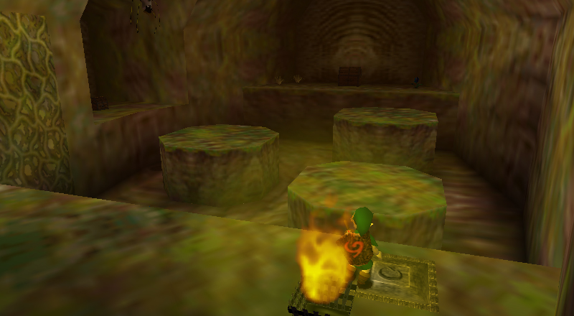
Motivation
My Game Idea
Enjoyable for All
Virtual Reality
Notes:
Portal + CoD + TLoZ + VR

Slide 4
Objective
Overarching goal: Create a game for engineering students that is both engaging to play and teaches them Digital Logic Circuits.

Slide 5
Design Requirements
The game should last about 30 minutes on average
Characters and Objects to interact with
5 Puzzles involving Digital Logic Circuits
1 Final Exam
Puzzle + Shooter Action Game
Virtual Reality compatible.

Slide 6
Design Constraints
Run on Virtual Reality
Specifically, the HTC Vive
30 Minute limit to prevent headaches
Must be playable in a limited space.
Like the size of a small classroom, for instance.

Slide 7
Design Approach
The story
World Around You
Your Objective
The Puzzles
5 Preset Puzzles
5Q Final Exam
The Characters
You
Enemies
NPCs
Main Antagonist
The Final Product
Main Setting
The Building
Starting Room
Hallways
Puzzles
Main Facility
UI Elements
Health
Object Interaction
Checkpoints
Teleportation
Notes:
5Q = 5 Question

Slide 8
System Diagram (Game Interaction)
Teleporting
Main Lobby
Hallway 1
D2B Puzzle
Hallway 2
Minterms Maxterms
Hallway 3
Boolean Algebra
Hallway 4
K-Map
Hallway 5
Boolean Circiut
Tutorial Room
Loading
Shooting
Loading
500 Unsigned?
500 Signed?
Shooting
Loading
All Minterms?
All Maxterms?
Correct Input?
Teleporting
Falling
Falling
Correct Inputs?
Senturion Dead?
DeMorgan’s Recreated?
Final Exam
4/5 Correct?
Senturions Defeated?
Ending

Slide 9
Task Plan
Design the Game’s Foundation
Develop the Game’s Plot
Establish the Game’s Structure
Designate Assets for the Project
Design the Game’s Hallways
Starting Room
First 3 Basic Hallways
Last 2 Advanced Hallways

Slide 10
Task Plan
Design the Puzzle Rooms
Decimal to Binary
Boolean Algebra
Minterms and Maxterms
K-Map
Digital Logic Circuit Design
Design the Game’s User Interface
Teleportation
Health System
Object Interactivity
Checkpoints

Slide 11
Task Plan
Design the Enemies
Braindead Trainees
Regular Security Patrol
The Senturion
Construct the Main Lobby
A Lively Office Space
The Final Exam
Verify the Program
Ensure Every Event Works Properly
Ensure The Loading Mechanism Works
Debugging

Slide 12
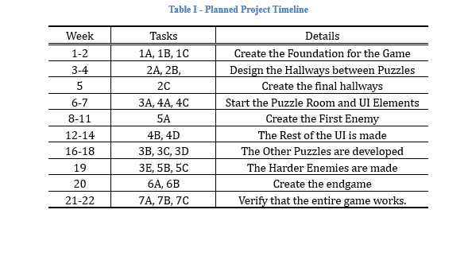
Project’s Timeline
Notes:
Could change EASILY.
Also, I may work on this over the summer.

Slide 13
Implementations!

Slide 14
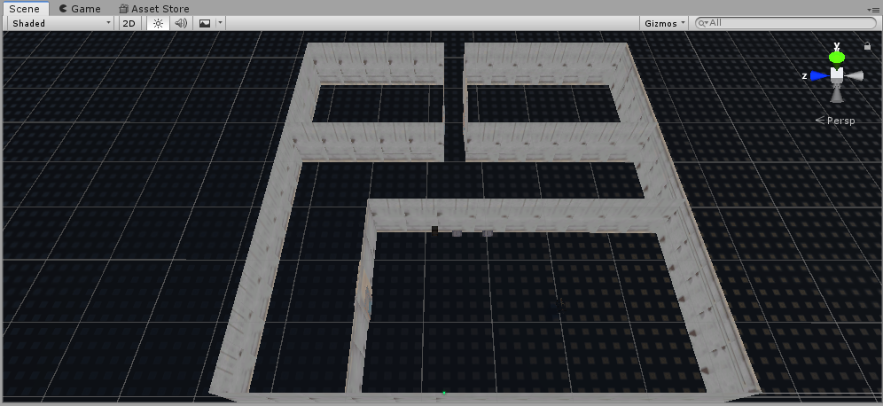
Implementing Subtask 1A
Plot
Escape the Rundown Facility
Expose the facility’s manager’s secrets
Learn Digital Logic Circuits
The Original Layout

Slide 15
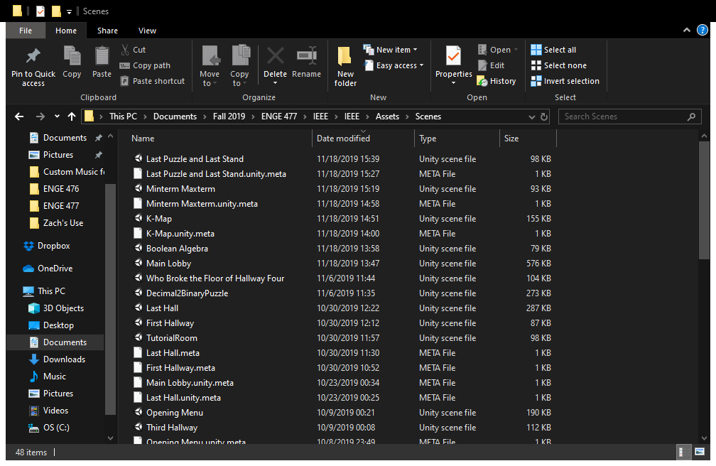
Implementing Subtask 1B
Each Room is its own scene.
Loading to be Implemented to navigate each scene.

Slide 16
Implementing Subtask 1C
SteamVR needed for VR to work
Factory-themed assets for the world.
Full List in the acknowledgements.
Notes:
Test Floor subject to change

Slide 17
Implementing Tasks 2 and 3: World Layout.
Tutorial
Hallway 2
Minterm Maxterm
Hallway 1
Decimal2Binary
Hall
3
Boolean Algebra
Hall 4
K-Map
Hall 5
Boolean Circuit.

Slide 18
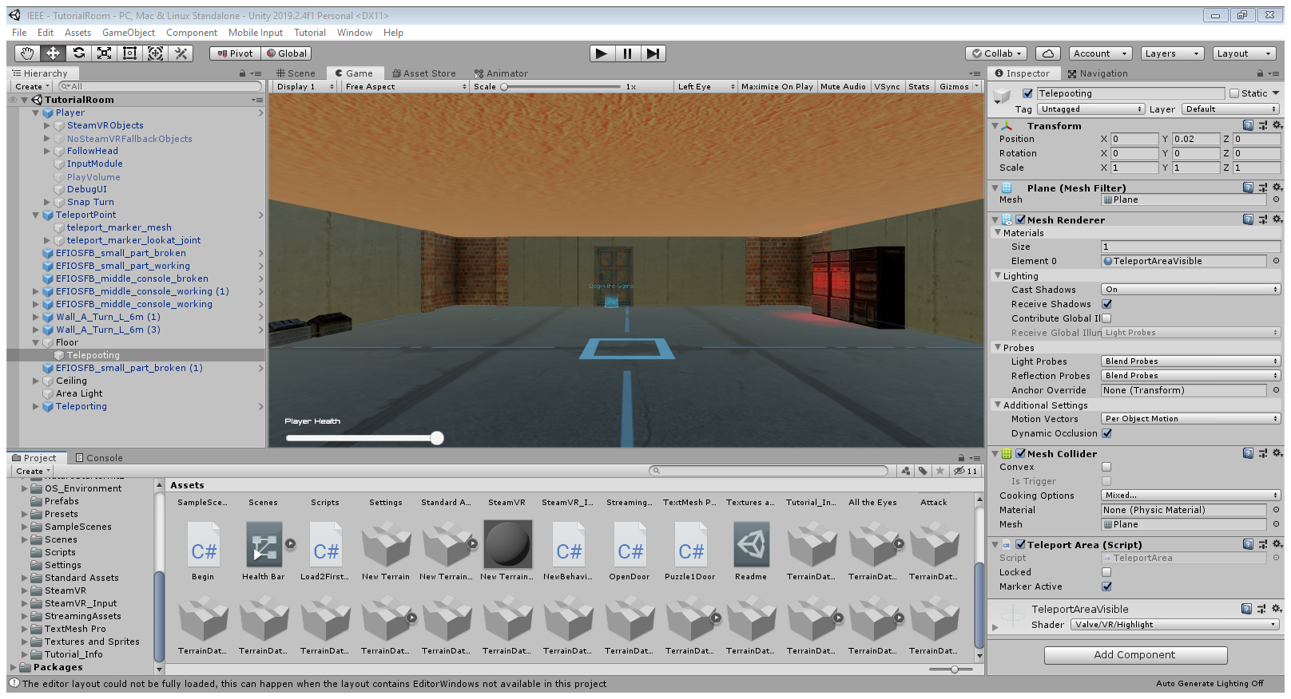
Implementing Tasks 2 and 3: World Layout.

Slide 19
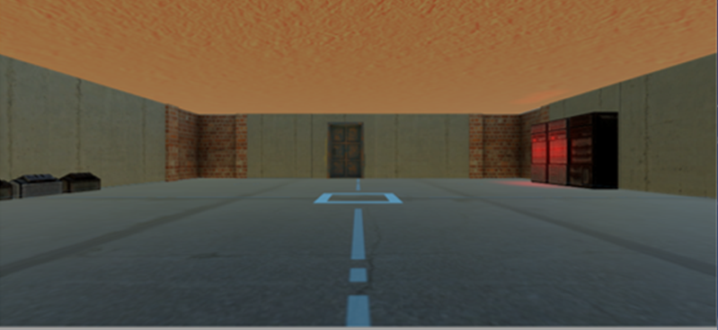
Implementing Subtask 2A
Starting Room
Adapt to Controls here.

Slide 20
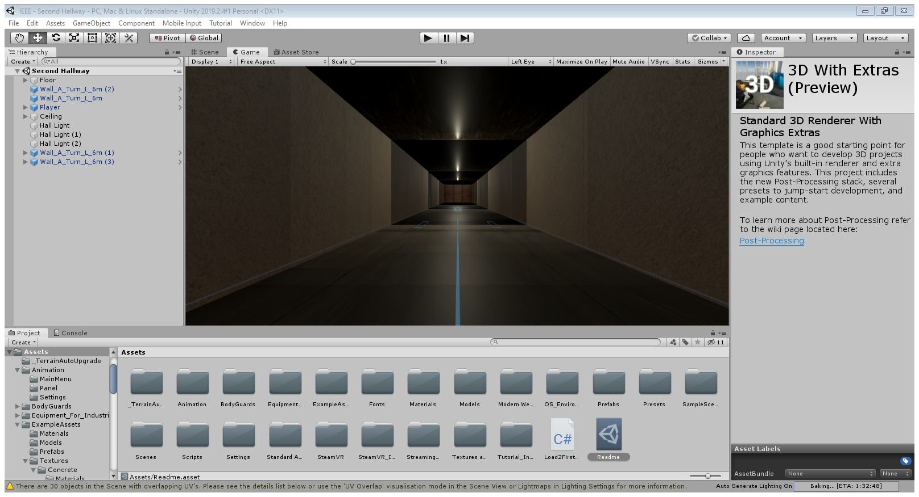
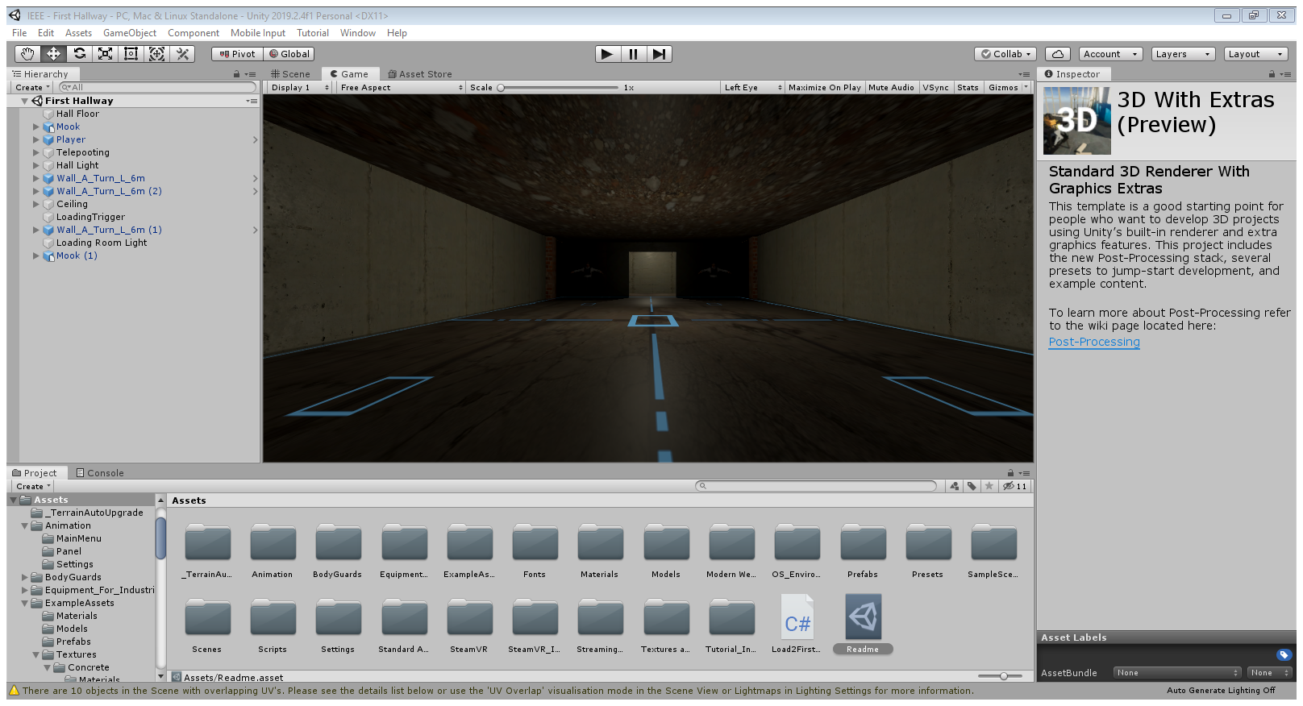
Implementing Subtask 2B
Second Hallway
First Hallway

Slide 21
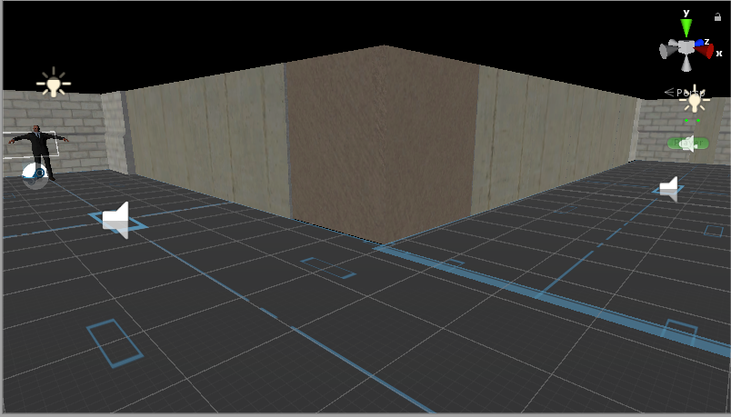
Implementing Subtask 2B
Third Hallway

Slide 22
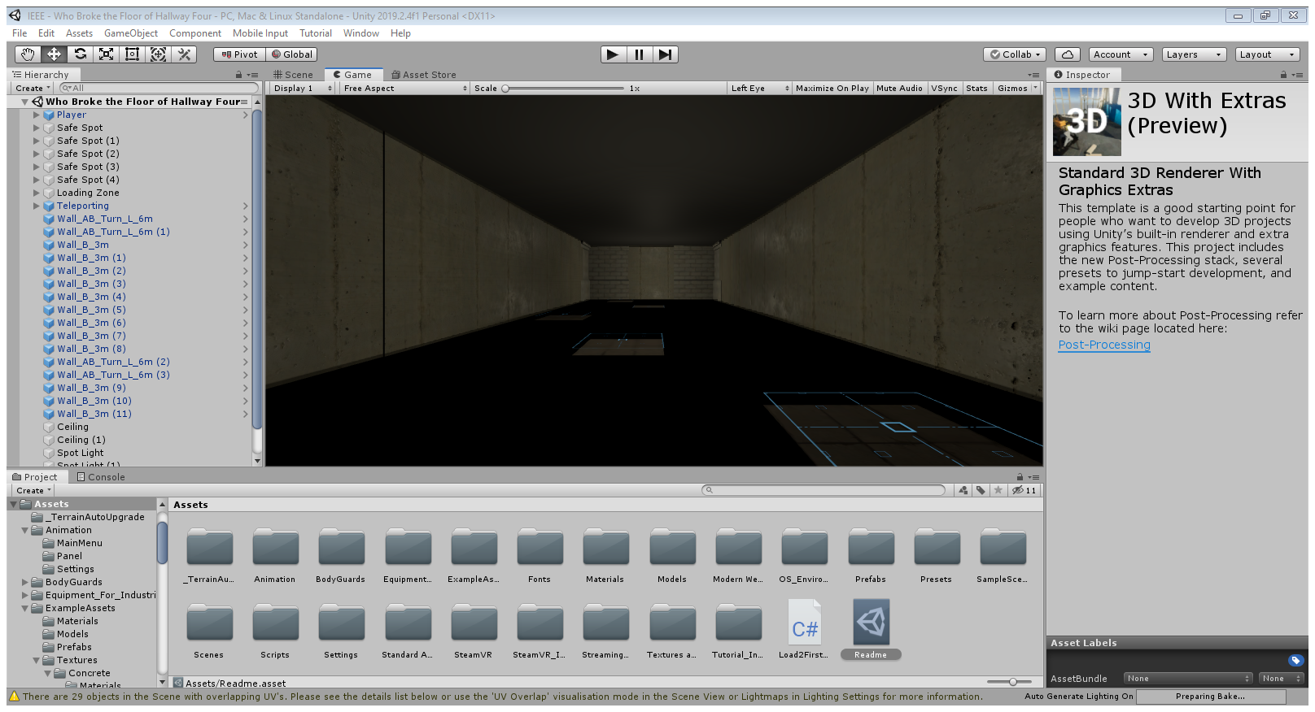
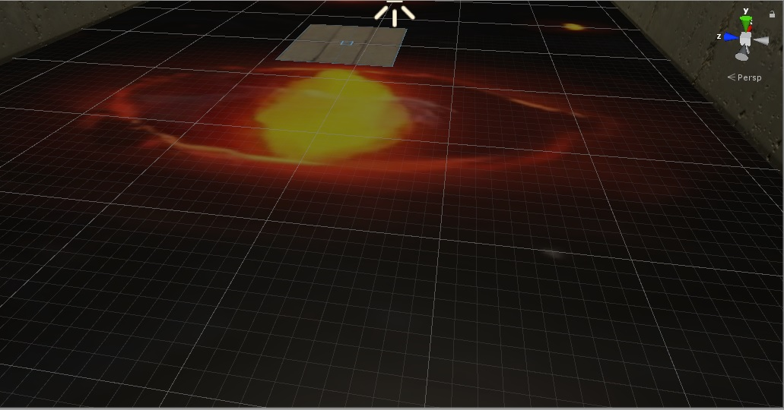
Implementing Subtask 2C
Fourth Hallway
Also Part of the 4th Hallway

Slide 23
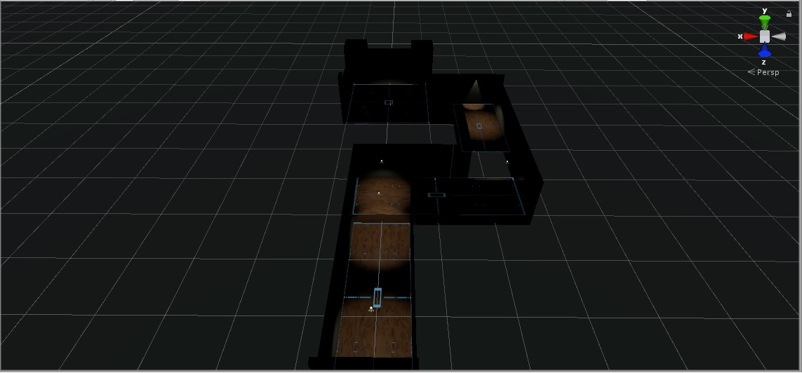
Implementing Subtask 2C
Last Hallway

Slide 24
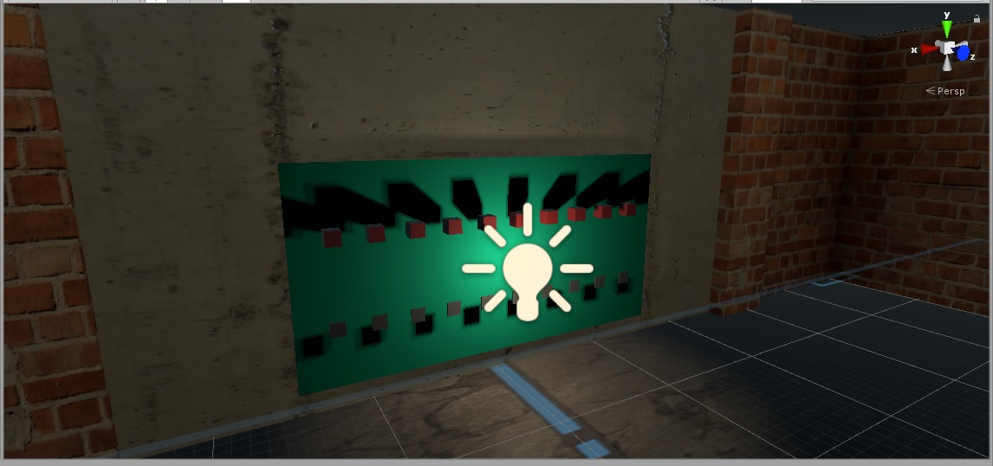
Implementing Subtask 3A
Decimal-To-Binary
Red = 0
Green = 1
10-bits
Use hint to convert number to binary
Then again, but its 2’s complement

Slide 25
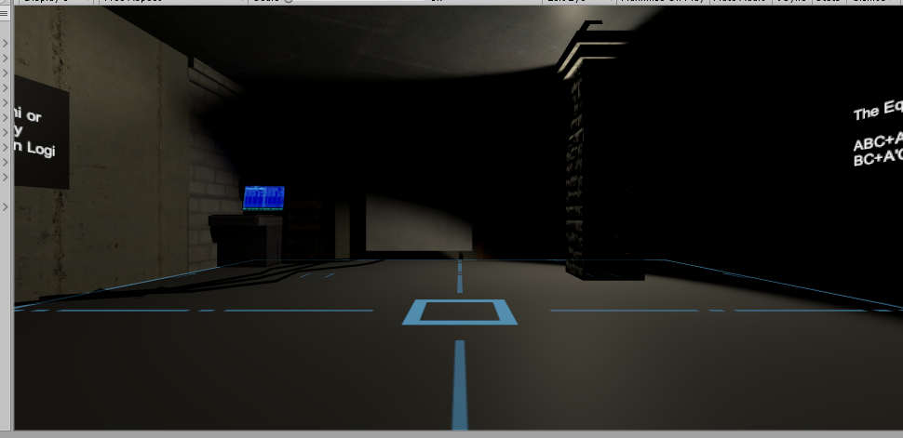
Implementing Subtask 3B
Boolean Algebra
1 Expression
1 Monitor to input answer
Wrong Inputs = -10 Health
Tests knowledge of Boolean identities.

Slide 26
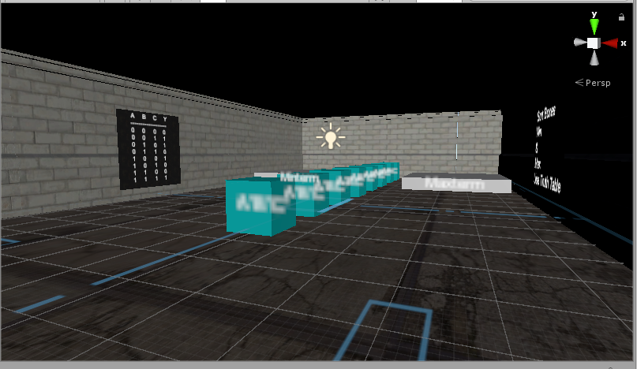
Implementing Subtask 3C
Minterms and Maxterms
Truth Table
2 Pedestals to sort each expression in
Once sorted, the puzzle’s cleared

Slide 27
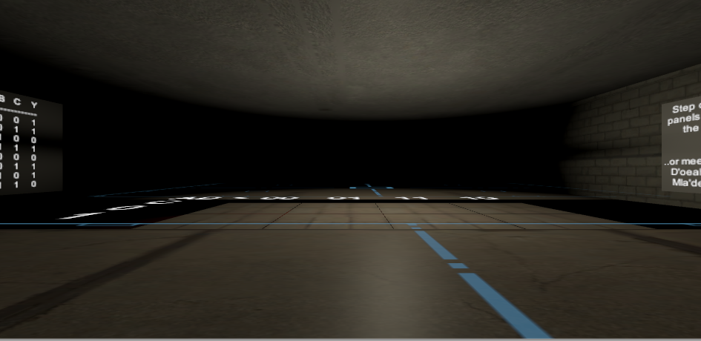
Implementing Subtask 3D
K-Map
1 Truth Table
8 Platforms
The ones that equal 1 can be stood upon
Stand on all valuing 1 to advance
Don’t fall!

Slide 28
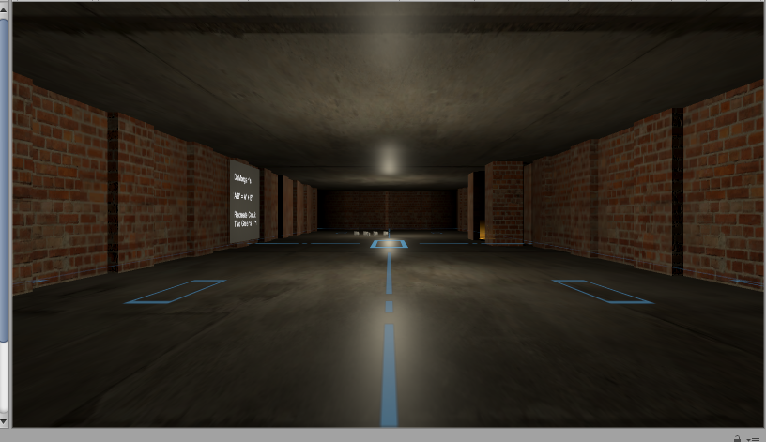
Implementing Subtask 3E
Boolean Circuit
1 Expression displayed
Gates to arrange
Build the correct circuit
DeMorgan’s?
Tier 2 enemies coming every minute

Slide 29
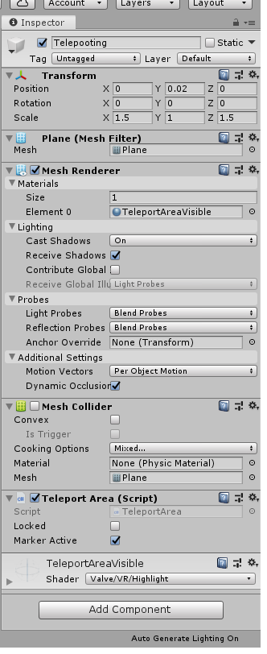
Implementing Subtask 4A
From the SteamVR Asset
Allows teleporting for better VR movement
Based off the “Floor” Plane
Done with the HTC Vive controller.

Slide 30
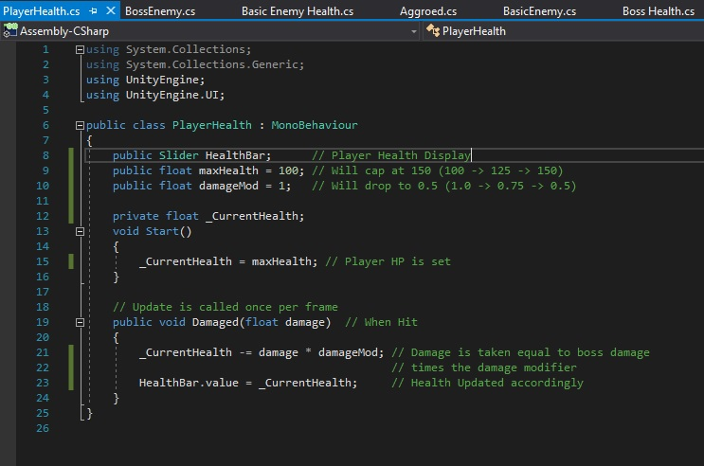
Implementing Subtask 4B
Player Health System
Always at 100
Represented by Slider
Screen Flashes when Damaged
Speaking of Damage
Starts at 10, but increases to 30
Will eventually take 50% damage from enemies
Just clear the puzzles!

Slide 31
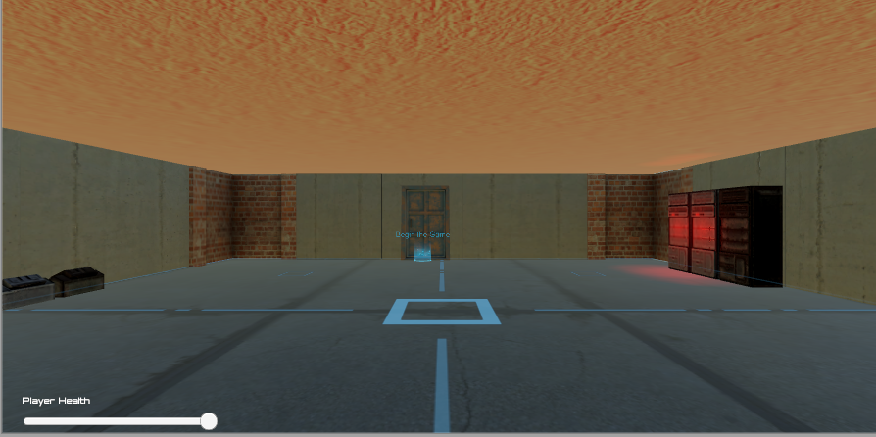
Implementing Subtask 4B

Slide 32
Implementing Subtask 4C
OF course, interactivity is key!
Needed to push buttons in puzzle 1
Shoot enemies in the hallways
Picking up objects in puzzles 3 and 5
And monitor inputs in puzzle 2 and the Final Exam

Slide 33
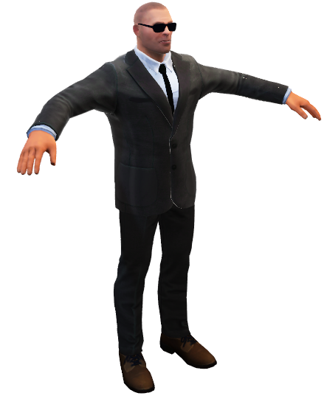
Implementing Task 5 Overview
From the “BodyGuards” asset
Three types:
Braindead Trainees
Bodyguards
Senturions
The braindead failed to leave the facility.
The bodyguards have a mission to keep you from escaping the facility.

Slide 34
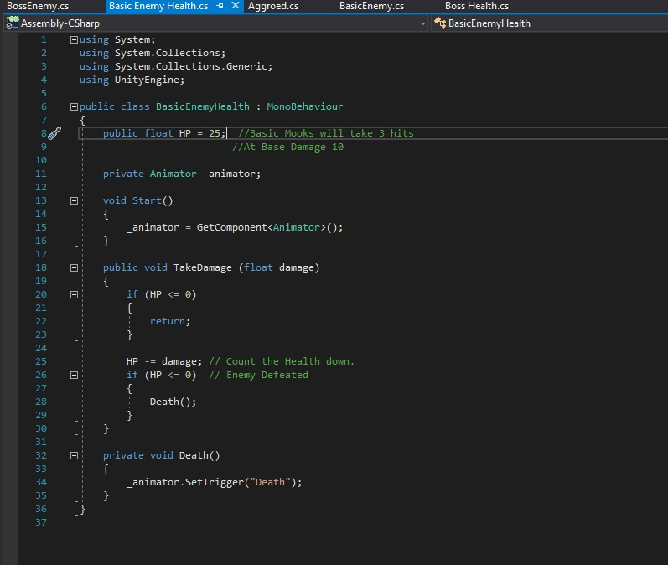
Implementing Task 5: Code
First Code showcases its health system
Braindead has 25
Bodyguards have 50
The Senturion has 255.

Slide 35
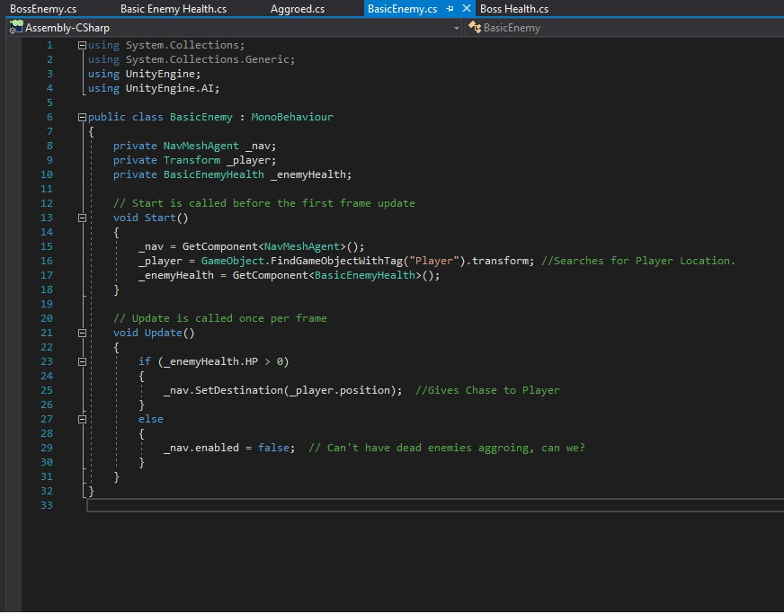
Implementing Task 5: More Code
Tracks the player
Contact = Damage
Braindead does 10 base damage
Bodyguards does 20 base damage
Senturion does 50 base damage.

Slide 36
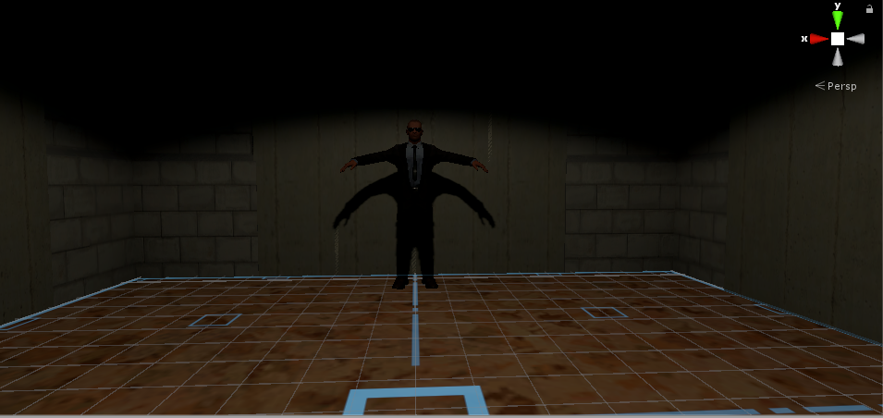
Implementing Subtask 5C in Detail
The Senturion
Appears in the Last Hallway
Splits into 2 at half health
Also appears if you fail the Final Exam, but 2 of them!

Slide 37
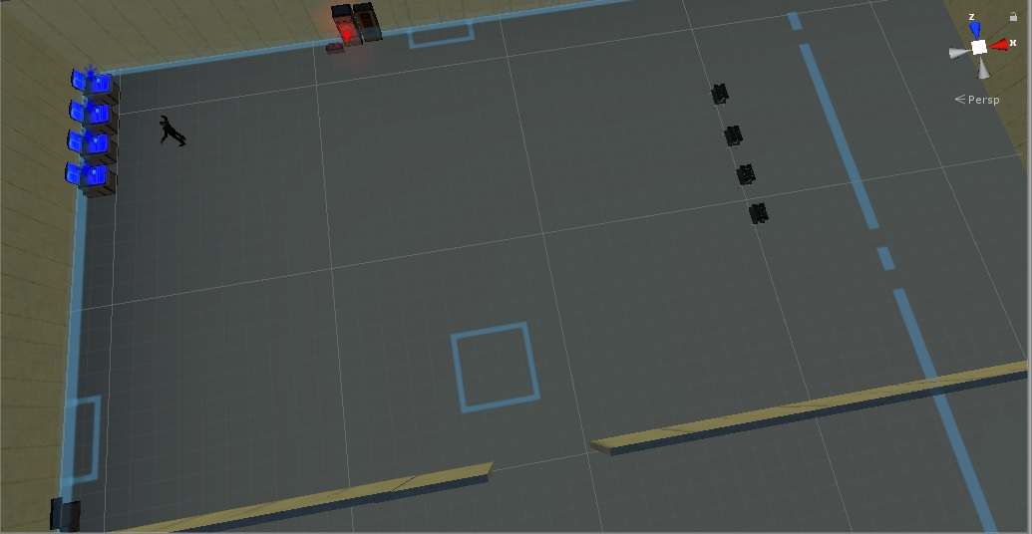
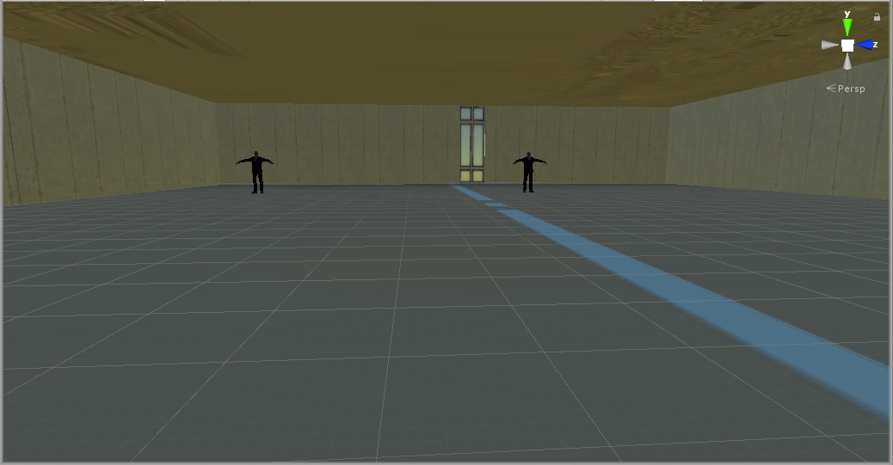
Implementing Subtask 6A

Slide 38
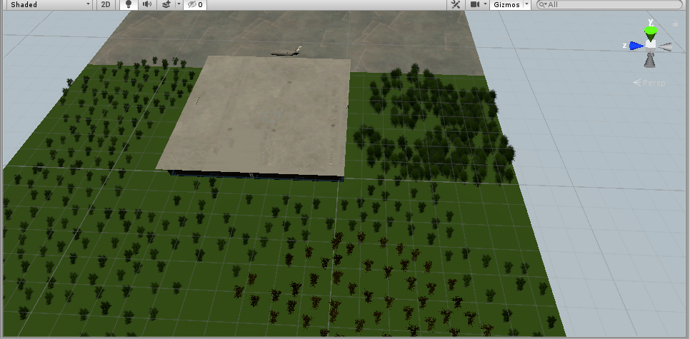
Implementing Subtask 6A

Slide 39
Implementing Subtask 6B
Final Exam
5 Questions
Get 4 right to instantly clear the game…
…or face 2 Senturions at the same time.
The ending is the same.

Slide 40
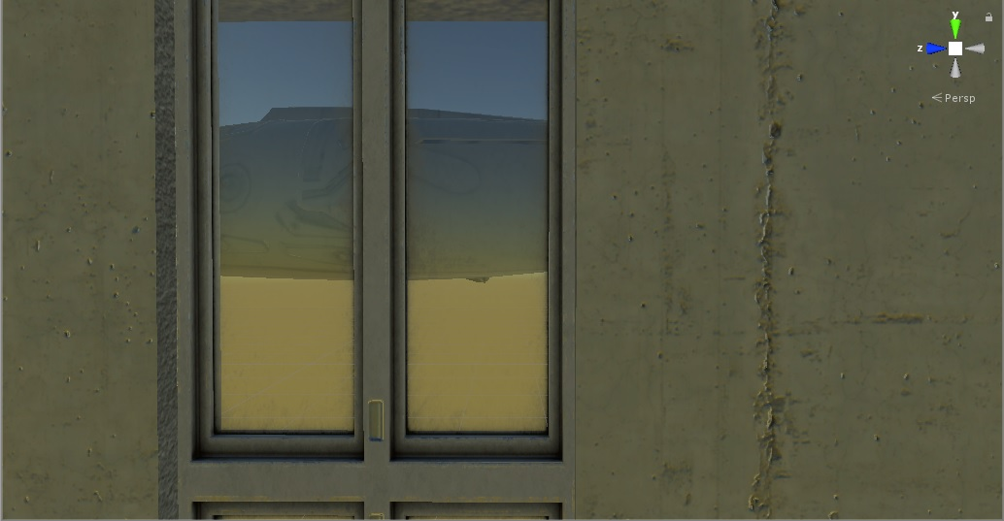
Implementing Subtask 6B
After the Final Exam
See this plane?
Takes you to Tyler’s GBL module
You are forced to end the game on the plane.

Slide 41
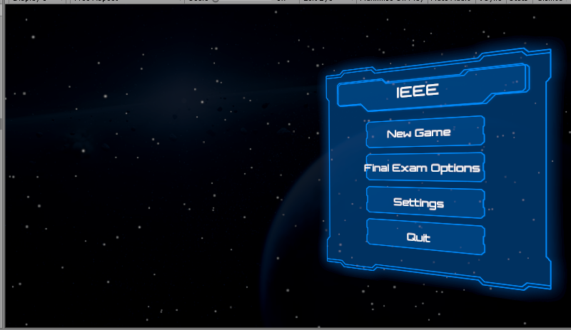
Manipulating the Final Exam
Found on the Main Menu
Based on Unity’s “UI” Asset Package
Just Press “Final Exam Options”
Here, professors can customize the questions
Note: Each question will have 3 options.

Slide 42
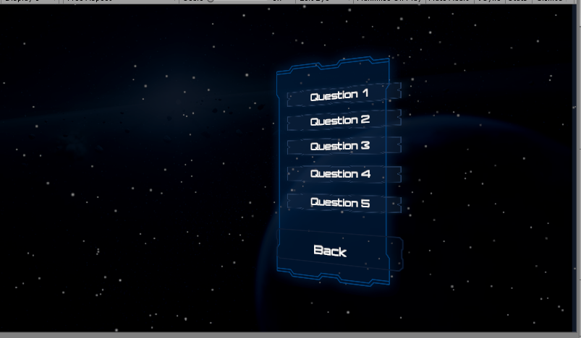
Manipulating the Final Exam
The Menu Itself
Button for Each Question
Customize the Question
…and 3 options.

Slide 43
Acknowledgements
Asset Creators
Unity for “Standard Assets” and “UI” asset packages
Valve for “SteamVR” asset package
Batewar for “Bodyguards” asset package
7XF Design for “Modern Weapons Pack” asset package
Ogasoda for “Modular factory environment” asset package.
Sevastian Marevoy for “Equipment for Industrial of Science” asset package
Shapes for “Nature Starter Kit 2” asset package
Others
Chiduben for assistance getting VR to work
Tyler for influencing some of my design choices with his own senior design project.

Slide 44
Questions?

Slide 45
Thank you!
Notes:
More in the future!

